Slide 1
Inheritance
JavaScript

Slide 2
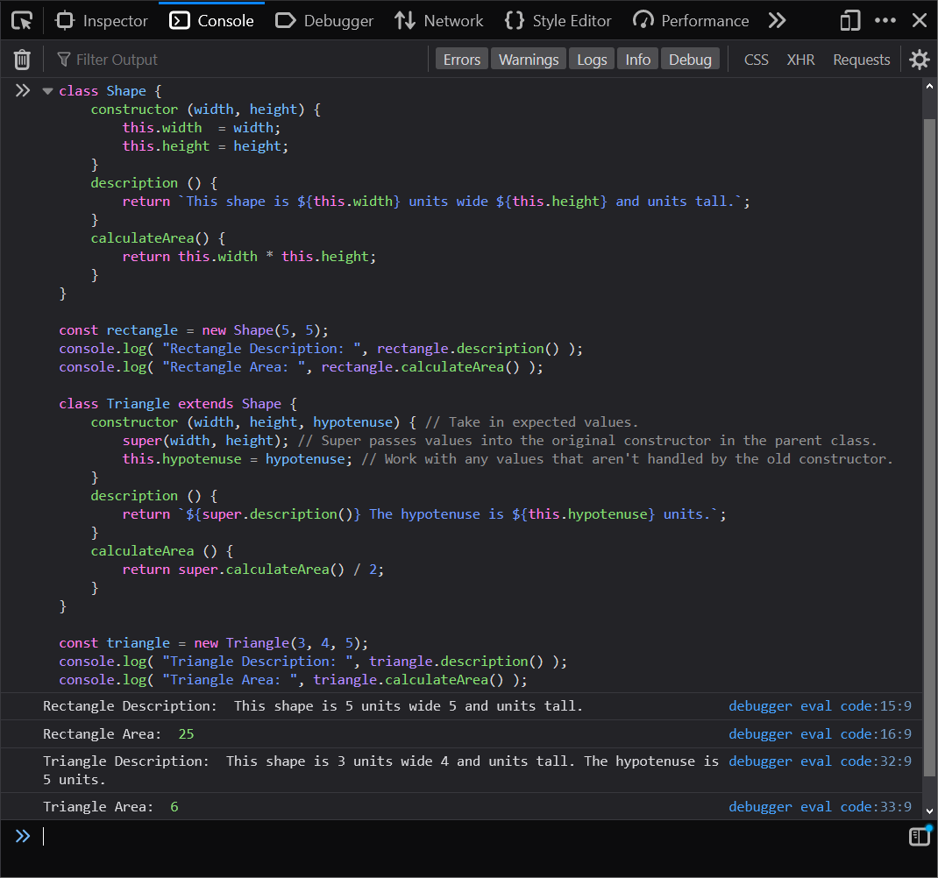
The extends and super Keywords
Give the following a try…
We can make a child class from an existing class using the extends keyword.
Notes:
See if you’re able to adapt the Shape class to work for other shapes by extending it with classes of your own!
class Shape {
constructor (width, height) {
this.width = width;
this.height = height;
}
description () {
return `This shape is ${this.width} units wide ${this.height} and units tall.`;
}
calculateArea() {
return this.width * this.height;
}
}
const rectangle = new Shape(5, 5);
console.log( "Rectangle Description: ", rectangle.description() );
console.log( "Rectangle Area: ", rectangle.calculateArea() );
class Triangle extends Shape {
constructor (width, height, hypotenuse) { // Take in expected values.
super(width, height); // Super passes values into the original constructor in the parent class.
this.hypotenuse = hypotenuse; // Work with any values that aren't handled by the old constructor.
}
description () {
return `${super.description()} The hypotenuse is ${this.hypotenuse} units.`;
}
calculateArea () {
return super.calculateArea() / 2;
}
}
const triangle = new Triangle(3, 4, 5);
console.log( "Triangle Description: ", triangle.description() );
console.log( "Triangle Area: ", triangle.calculateArea() );

Slide 3
Class Property and Method Accessibility
There are access permission levels afforded to class properties and methods to help us control more finely how our classes will be used and if or how properties can be accessed / modified.
In JavaScript, these features / keywords are currently proposed, and not released in modern browsers as of yet.
By default all properties and methods in a JavaScript class are considered public (unless they are stated or set to behave otherwise.) This means that we can access, or potentially even reassign, properties and methods in objects following the classes (blueprints) that we write.
Private properties and methods are accessible only from within the class itself. That is, to say, that a private property defined within the class is only accessible in that class’ code block. Private properties or methods are prepended with an octothorpe (#).
If you instantiate an object from a class, and a property or method that you’re attempting to access or execute is private, you’ll simply be met with an error as a response instead of the desired effect.
As a developer this helps us control values and our functionality more closely, and prevent unexpected use-cases from coming up in our objects.
Notes:
Click the links to learn more about this future JavaScript addition.

